Slide 1
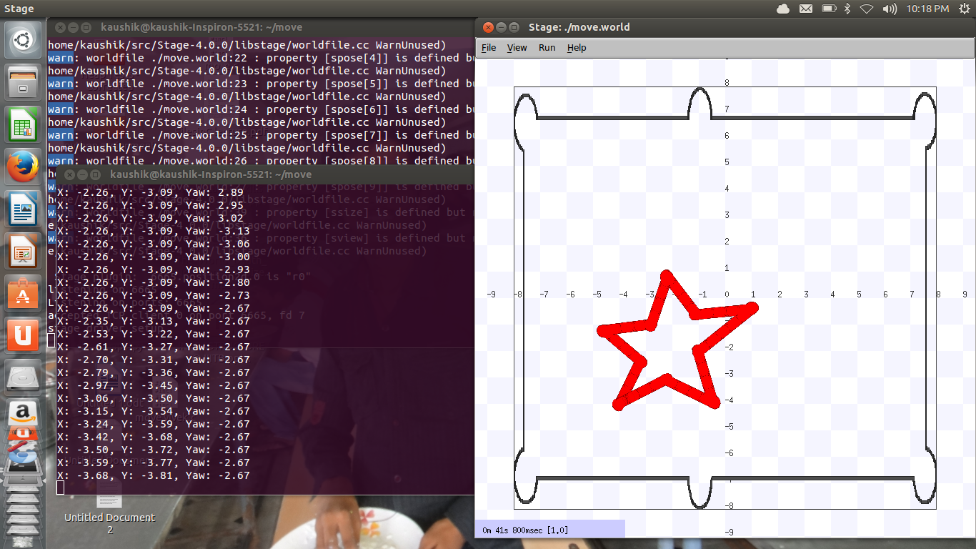
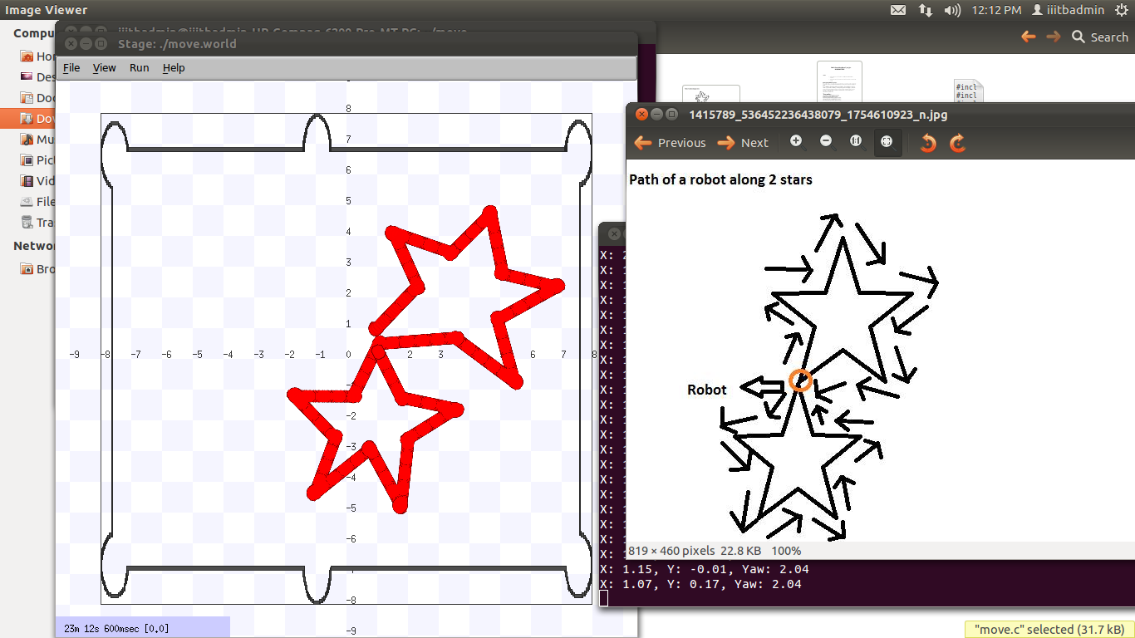
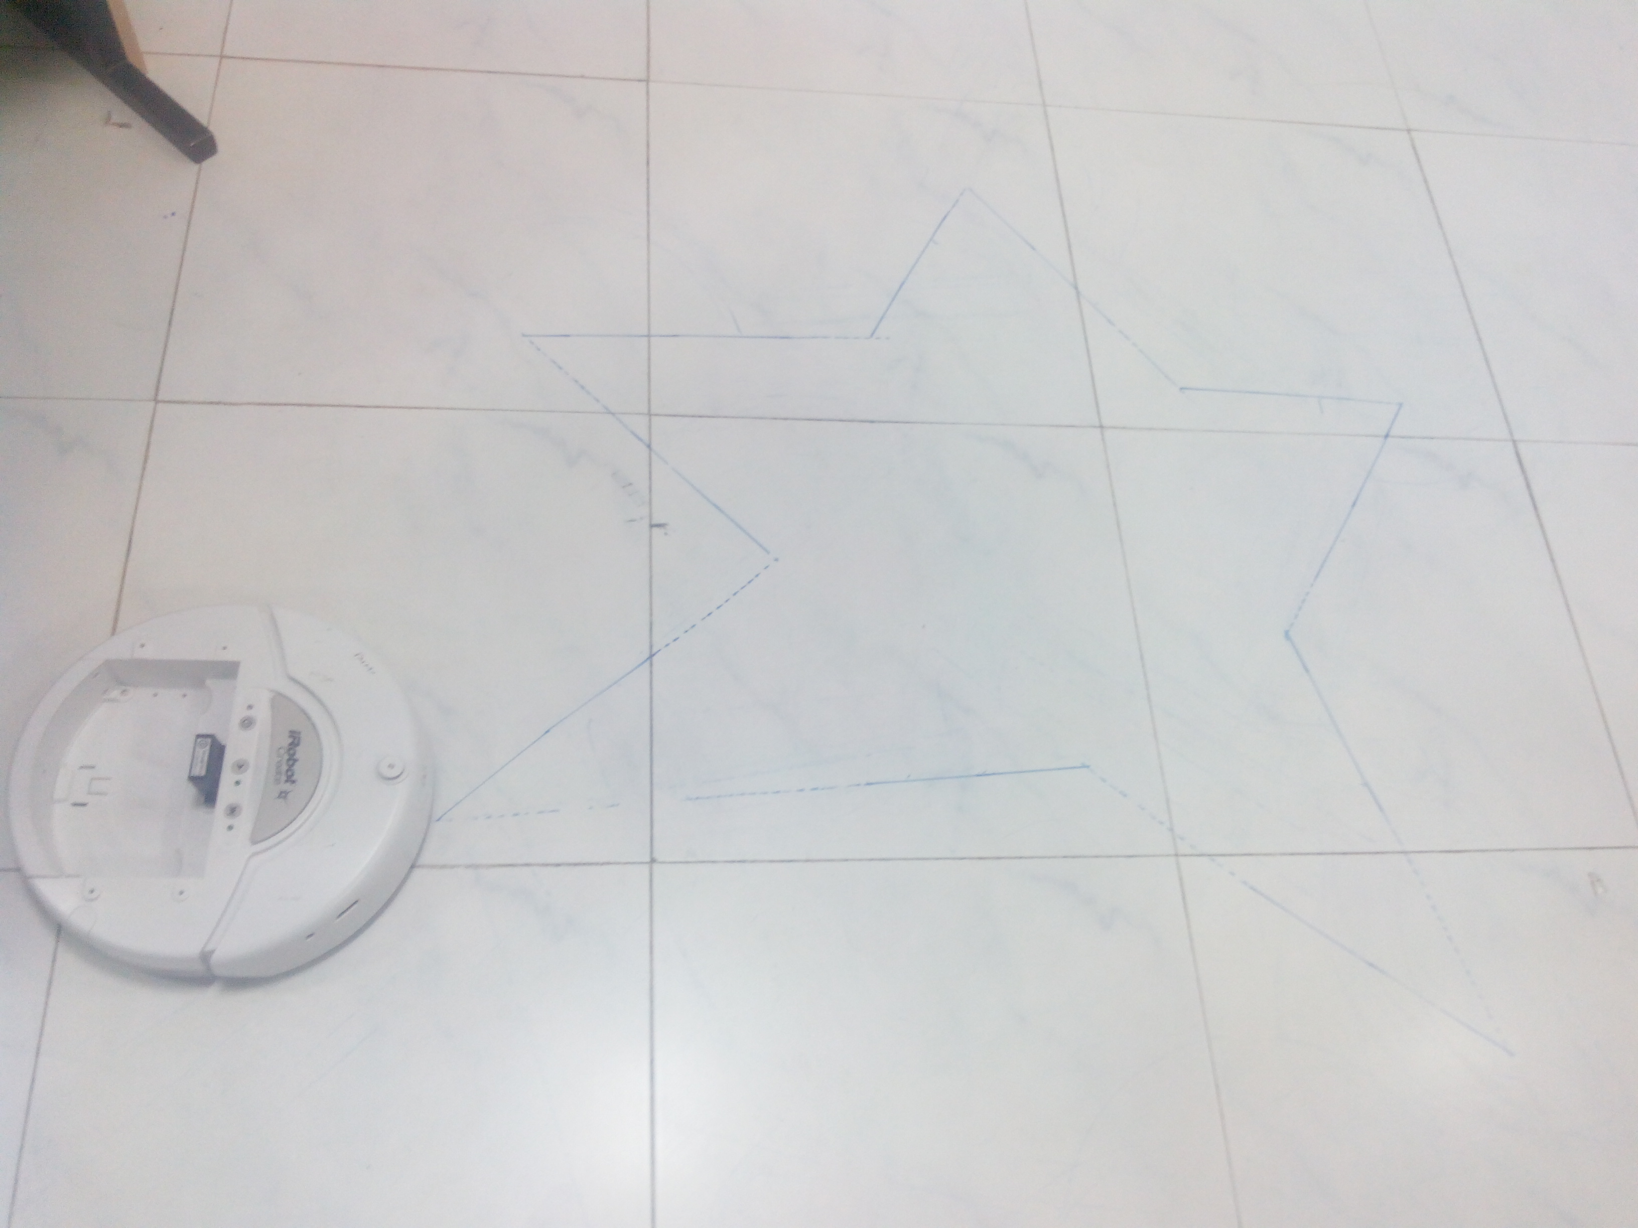
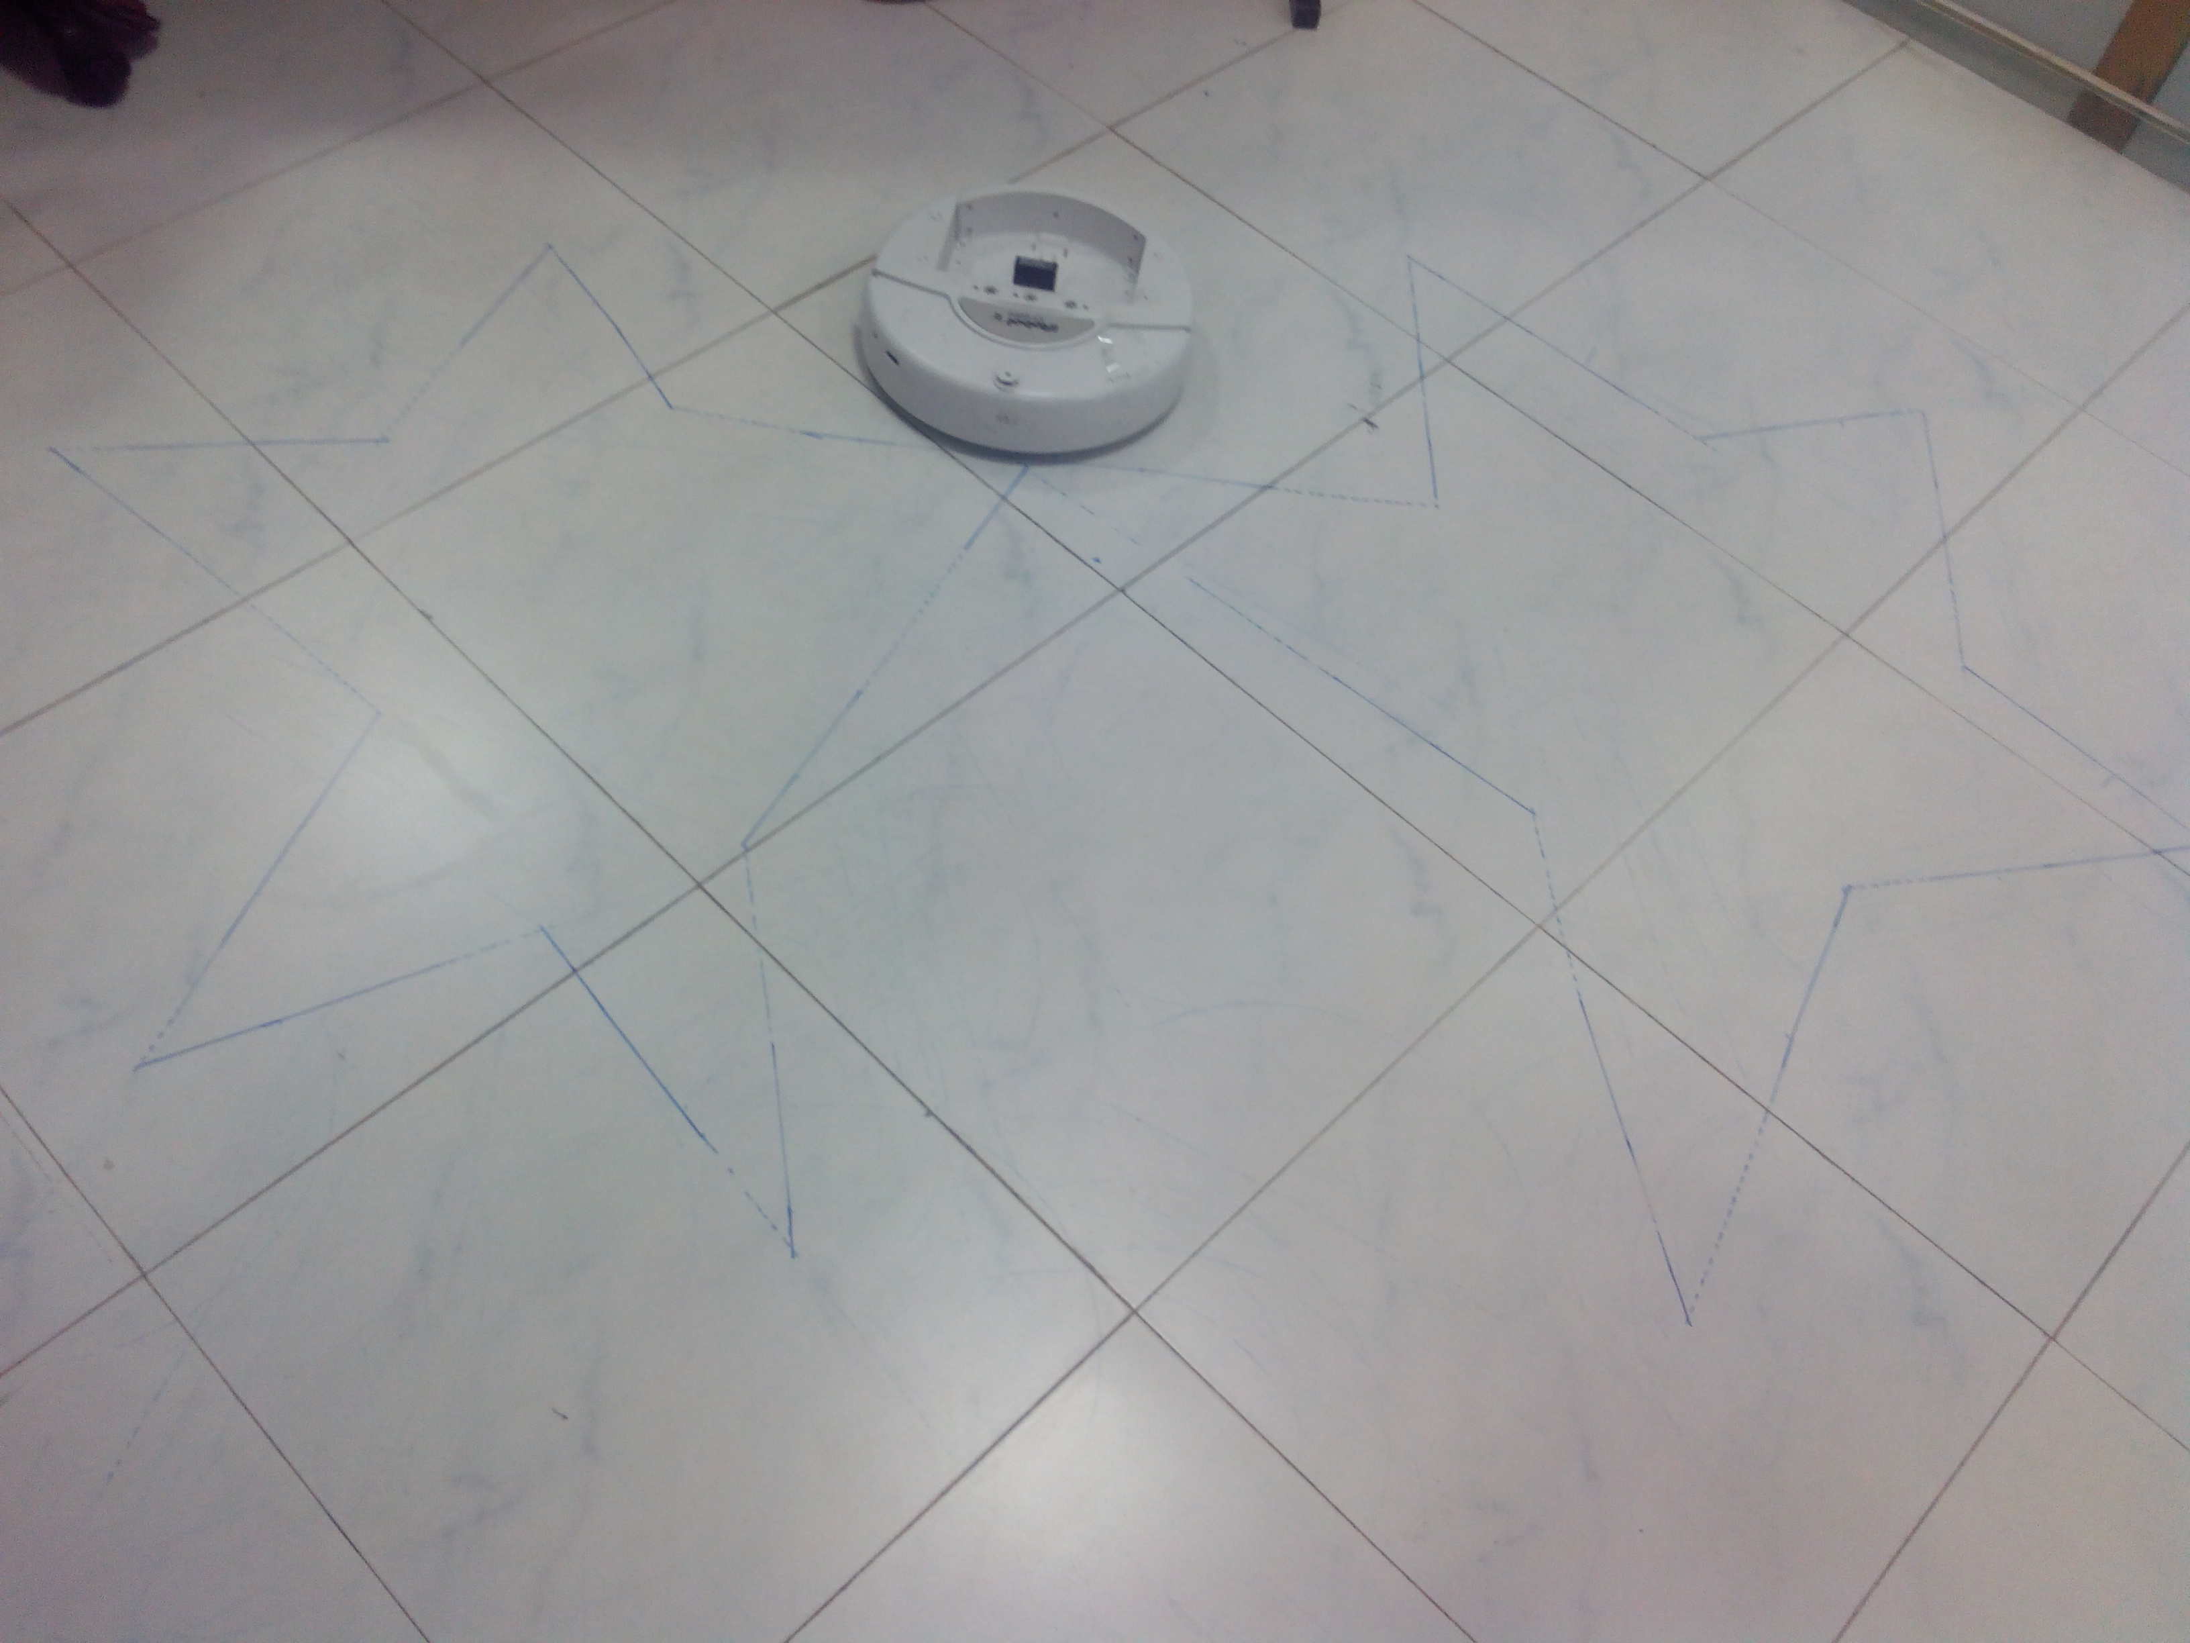
0
iSTAR
Aishwarya Yandapalli, Kaushik, Prudhvi, Krishna Chaitanya and Aishwarya Reddy
Introduction
In this project iRobot draws the stars upto 2 when the number of stars are given as input.
Results
Following are the images for brief understanding of the project.
Images of the two stars in simulation followed by robotic movement.
.
Conclusions and future work
The code written for simulator is completely different from that of i-Robot, also the figure drawn by the simulator keeps changing with time. The robotic project given to us was so interesting as many of us captured interest in robotics and planning to take up some more projects in future.
Materials and methods
The materials and methods of this project are
1.i-Robot
2.White board marker : To draw the stars
3.Bluetooth-Dongle:To connect the iRobot with the computer.
`
In the line 5 there is a function “player2d_position2d_set_cmd_vel(a,b,c,d,e);”
.
References
1.How to use player/stage by Jennifer Owen.
2. Player stage PDF
Acknowledgments
We thank our professor Madhav Rao sir for making us familiar about the working of i-Robot.
Notes:
Copyright Colin Purrington (http://colinpurrington.com/tips/academic/posterdesign).

